Slide 1
Marker Decision Tree for Authentic Effort & AI Use
A systematic approach to assess originality and AI involvement
Notes:
---

Slide 2
Introduction
Notes:
Overview and Purpose

Slide 3
Overview and Purpose
Guide for Educators
The presentation helps educators identify AI-generated content ensuring academic integrity in student submissions.
Step-by-Step Decision Tree
A structured approach reviews disclosures, evidence, suspicious features, and oral checks to evaluate submissions.
Promoting Fair Marking
Supports consistent marking practices while encouraging transparency and accountability among students.
Notes:
This presentation provides a comprehensive guide to the Marker Decision Tree for evaluating authentic student effort and AI use in academic submissions. It is designed to help educators and assessors navigate the process of identifying AI-generated content and ensuring academic integrity. The decision tree outlines a step-by-step approach for reviewing student disclosures, evaluating process evidence, identifying suspicious features, and conducting oral checks when necessary. The goal is to support fair and consistent marking practices while promoting transparency and accountability among students.

Slide 4
Marker Decision Tree Flowchart
Notes:
Visual Representation of Decision Steps

Slide 5

Visual Representation of Decision Steps
Initial AI Disclosure Check
  Begin with verifying if the student has disclosed AI use through a formal disclosure form.
Evaluation of Submission
  Assess submissions for suspicious features like writing style changes or generic content when no disclosure is present.
Evidence Review and Oral Check
  Request additional evidence or conduct brief oral checks if concerns arise about submission authenticity.
Final Outcome Decisions
  Decide to confirm authentic effort, accept disclosed AI use, or escalate for academic review based on findings.
Notes:
The flowchart visually represents the Marker Decision Tree, starting with the initial check for student disclosure of AI use. If a disclosure form is present, the marker reviews the evidence and proceeds to assess authenticity. If no disclosure is provided, the marker evaluates the submission for suspicious features such as sudden changes in writing style, generic content, or improbable depth. If concerns arise, the marker requests additional evidence or conducts a brief oral check. The final outcomes include confirming authentic effort, accepting disclosed AI use, or escalating the case for academic integrity review. This structured approach ensures clarity and consistency in decision-making.

Slide 6
Checklist for Authentic Effort
Notes:
Key Indicators of Student Engagement

Slide 7

Key Indicators of Student Engagement
Evidence of Drafts and Iteration
  Presence of drafts and version history demonstrates planning and continuous improvement in student work.
Reflection and Disclosure
  Submission of AI disclosure forms and reflective explanations highlights transparency and thoughtful decision-making.
Citations and Academic Integrity
  Accurate citations and plagiarism checks ensure credibility and uphold academic honesty in submissions.
Consistent Writing Style
  A logical flow and consistent style throughout the work indicate genuine engagement and careful writing.
Notes:
The checklist outlines essential indicators of authentic student effort. These include the presence of drafts, notes, or version history; evidence of planning and iteration; submission of AI disclosure forms and prompt logs; a reflection section explaining choices and challenges; accurate and verifiable citations; consistent writing style and logical flow; and completion of a plagiarism check. Markers use this checklist to evaluate the depth and transparency of the student's work, ensuring that the submission reflects genuine engagement and academic integrity.

Slide 8
Rubric for Authentic Effort
Notes:
Evaluation Criteria and Performance Levels

Slide 9
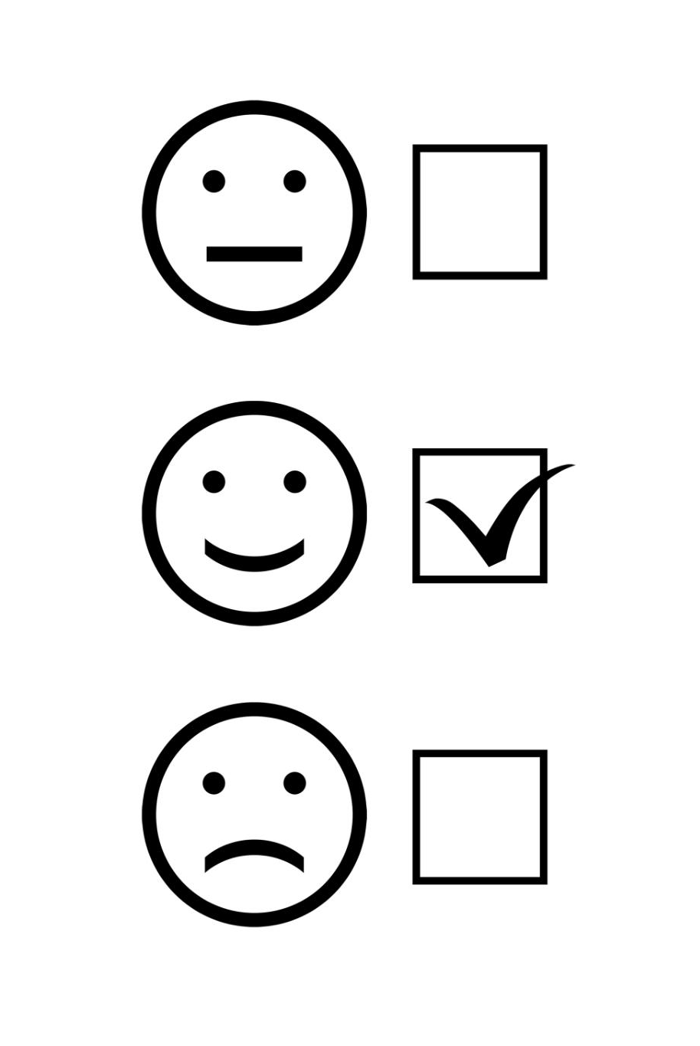
Evaluation Criteria and Performance Levels
Structured Assessment Framework
  The rubric defines five key criteria to evaluate authentic effort in student work systematically.
Performance Levels
  Each criterion is assessed at Basic, Adequate, and Strong levels to differentiate student performance effectively.
Examples of Criteria Application
  Strong Process Transparency features clear iteration and multiple drafts, while Basic shows minimal evidence.
Consistent Feedback Tool
  The rubric supports consistent grading and provides meaningful feedback to enhance student learning.
Notes:
The rubric provides a structured framework for assessing authentic effort across five key criteria: Process Transparency, Reflection & Self-Explanation, Methodological Ownership, Provenance & Citation Hygiene, and Consistency & Development. Each criterion is evaluated at three performance levels: Basic, Adequate, and Strong. For example, strong performance in Process Transparency includes clear iterative processes and multiple drafts, while basic performance may show minimal evidence. This rubric helps markers apply consistent standards and provide meaningful feedback to students.

Slide 10
Sample Reflection Paragraph
Notes:
Model Example of Student Reflection

Slide 11

Model Example of Student Reflection
Articulation of Thought Process
  Students explain their reasoning, challenges, and decision-making during the project to show transparency.
Planning and Iteration
  Reflection includes details about planning stages and iterative improvements made throughout the project.
Source Evaluation and Methodology
  Students discuss their evaluation of sources and choices of methods used in their work for critical thinking.
Learning Journey Insights
  Reflections provide markers with insights into students' learning progress and reinforce work authenticity.
Notes:
The sample reflection paragraph demonstrates how students can articulate their thought process, challenges faced, and decisions made during the project. It includes details about planning, iteration, source evaluation, and methodological choices. This example serves as a guide for students to write their own reflections, emphasizing the importance of transparency and critical thinking. By including such reflections, students provide markers with valuable insights into their learning journey and reinforce the authenticity of their work.

Slide 12
Key Tips for Markers
Notes:
Best Practices for Evaluating Submissions

Slide 13

Best Practices for Evaluating Submissions
Transparency About AI Use
  Markers should clarify any AI assistance used in submissions to promote honesty and clarity in grading.
Evaluating Student Process
  Look for clear evidence of the student’s problem-solving and learning process within their submission.
Citation Verification
  Verify all citations for accuracy to maintain academic integrity and proper referencing standards.
Consistency and Reflection Review
  Maintain consistency in style and logic while reviewing reflection sections for critical reasoning.
Notes:
Markers are encouraged to follow best practices when evaluating student submissions. These include being transparent about AI use, looking for evidence of the student's process, verifying citations, maintaining consistency in style and logic, and reviewing reflection sections for reasoning. By adhering to these tips, markers can ensure fair and thorough assessments, uphold academic standards, and support student development. These practices also help in identifying potential integrity issues and addressing them appropriately.

Slide 14
Conclusion
Notes:
Final Thoughts and Acknowledgements

Slide 15

Final Thoughts and Acknowledgements
Fostering Integrity in Education
  Implementing strategies encourages a culture of academic honesty and meaningful learning.
Comprehensive Evaluation Framework
  Decision tree, checklist, and rubrics provide tools for assessing authentic student effort in AI context.
Collaboration for Effectiveness
  Ongoing collaboration and transparency between students and educators ensures successful implementation.
Notes:
Thank you for engaging with this comprehensive guide on the Marker Decision Tree for Authentic Effort and AI Use. By implementing the strategies and tools presented, educators can foster a culture of integrity and support meaningful learning experiences. The decision tree, checklist, rubric, and reflection examples provide a robust framework for evaluating student work in the age of AI. Continued collaboration and transparency between students and educators will ensure the effectiveness of these practices.

